Slide 1
Book-Crossing
A Recommender System Case Review
Presented by:
Anthony Chen Evelyn Liu
Julie Yang
Sumith Baby

Slide 2
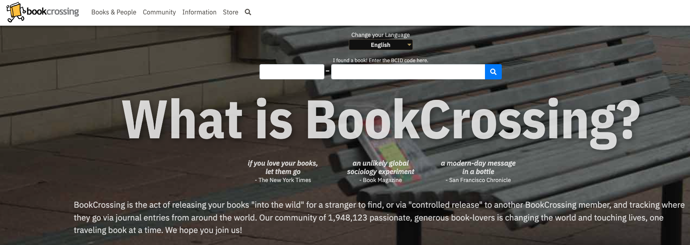
Contents
Introduction to recommender systems and industry application
Personalized recommendation
Methodology Used
Dataset Overview
Data Prep/Clean/Processing Techniques
Non-personalized recommendation
Code Walkthrough
Some problems with dataset/methodology
Advantages and Disadvantages

Slide 3
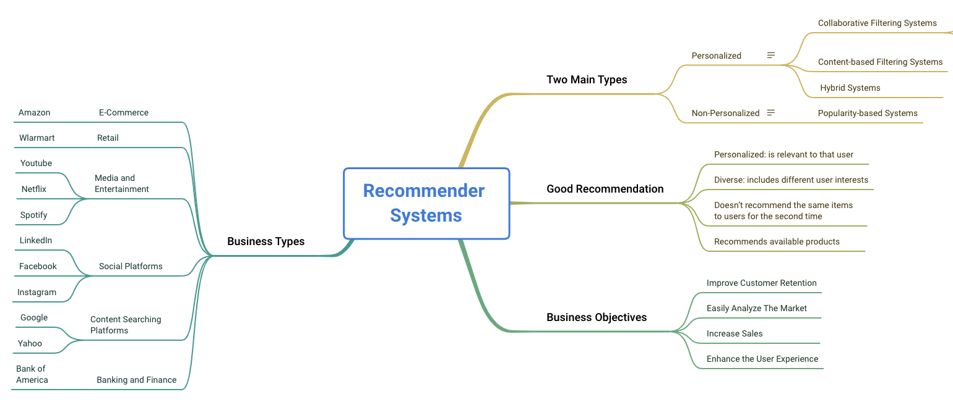
Industry Applications

Slide 4
Personalized Recommendation
Collaborative Filtering Systems
Content-Based Systems
Hybrid Systems
User-item interactions
Aggregate users and analyse the common interest in them to an object.
Collects personal ratings, likes, reviews, etc…
Characteristic Information
For each user they will have their own profile of taste and Ratings.
With those information they recommend identical objects.
Combination of both types of information
Overcomes the limitations of both content-based and collaborative filtering method

Slide 5
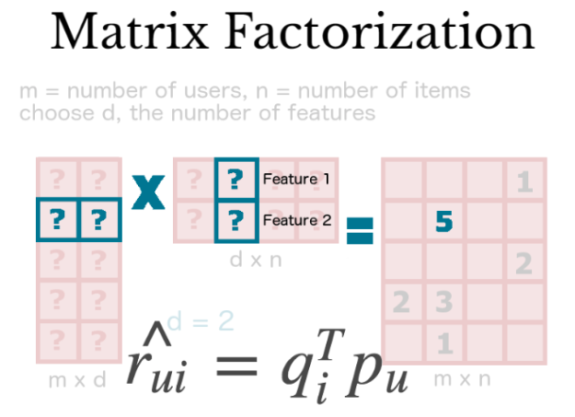
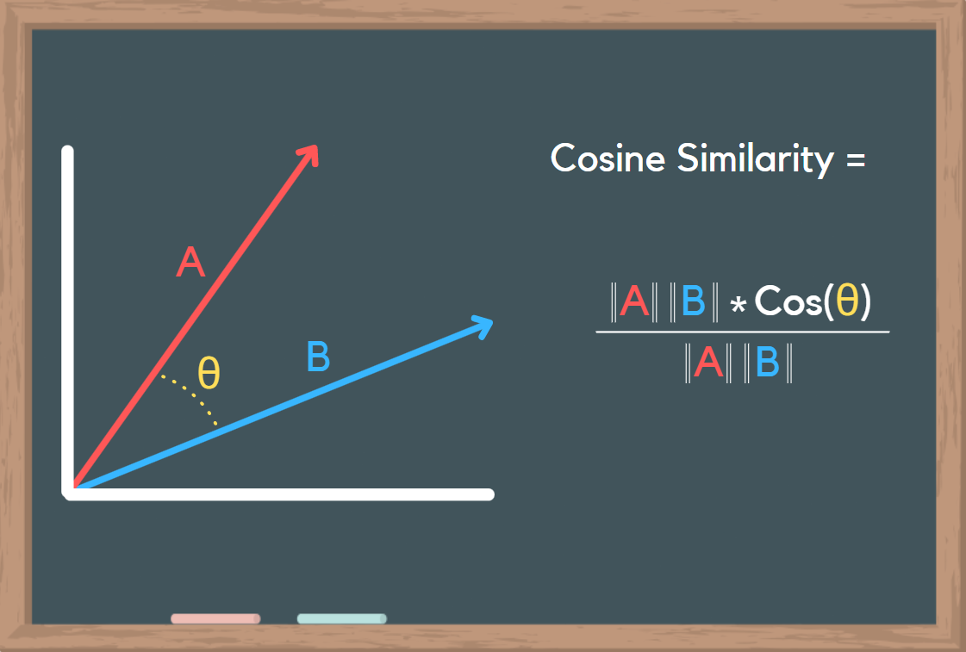
Technique: Collaborative Filter
Methodology: User-Based
ML algorithm: KNN
Score Function: Cosine Similarity
What is User-Based Collaborative Filtering?
Users with similar characteristics share similar interest and tastes
If Vinny and Adam currently both like the same books (Twilight), then it’s reasonable to assume that they will continue to like the same books in the future (50 Shades of Grey)
What is Cosine Similarity?
Helps determine/find users with similar tastes
How does it find the similarity?
Calculated over the ratings both users have rated before
Measured by cosine of the angle between two vectors
Determines if whether the vectors are pointing the same way
Smaller the angle, the more similar their directions are

Slide 6
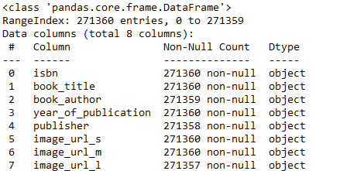
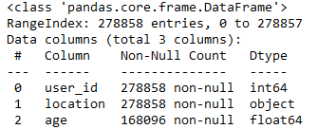
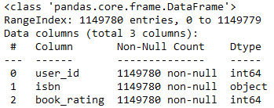
High Level Dataset View
Books
Users
Ratings

Slide 7
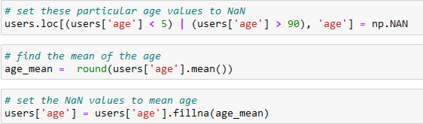
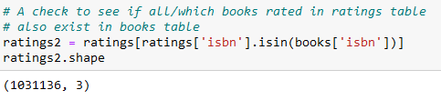


Data Preprocessing Techniques
Age Imputing: replace NaN, < 5, and > 90
Problem: Some books rated in ratings table did not exist in the books table. Gave us a hint on how to join the datasets
Google Search: Find missing publisher
Statistical Significance filtering

Slide 8
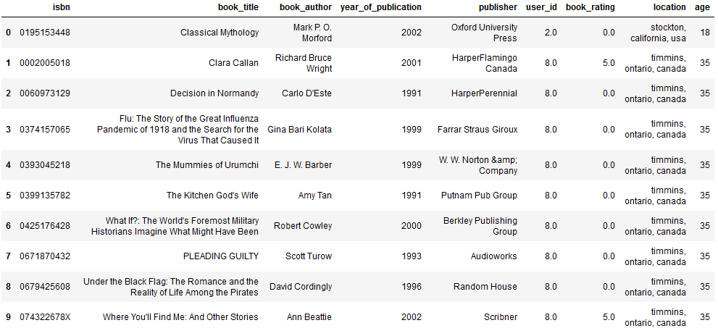
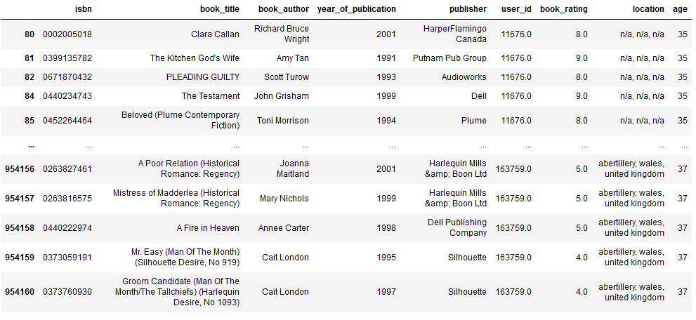
Brief Code Walkthrough - after most data has been cleaned
df = books.merge(ratings, on='isbn', how='left').merge(users, on='user_id', how='inner')
Final DataFrame
# filter rows of explicit book_ratings → discussed in the next slide
dfe = df[df['book_rating'] != 0]
# drop duplicate rows of same ‘user_id’ and ‘book_title’
df_filtered = df_filtered.drop_duplicates(['user_id', 'book_title'])
# statistical significance filtering → discussed in previous slide
user_id_counts = dfe['user_id'].value_counts()
greater99 = user_id_counts[user_id_counts>=100].index
df_filtered = dfe[dfe['user_id'].isin(greater99)]

Slide 9
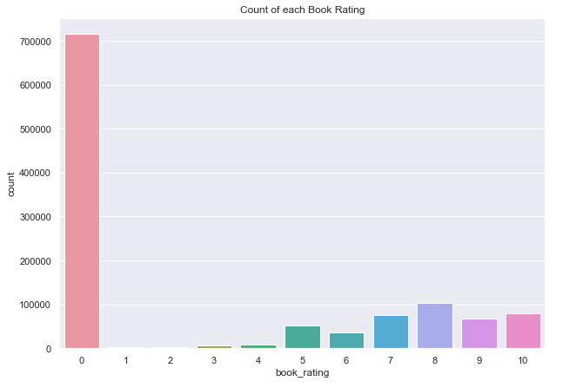
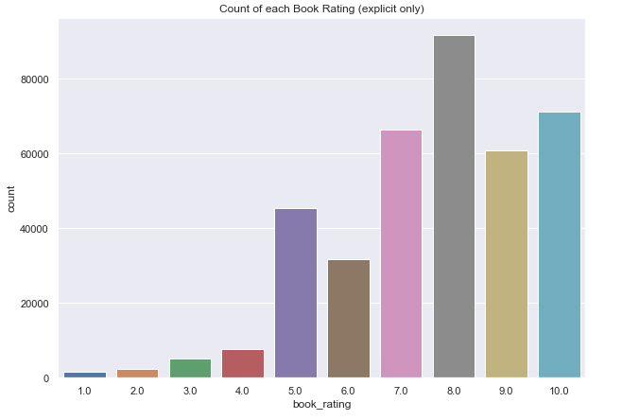
A Problem with User-Based Filtering
Implicit Rating: Zero’s because no rating was entered
Explicit Rating: Ratings from 1-10
Solution!

Slide 10
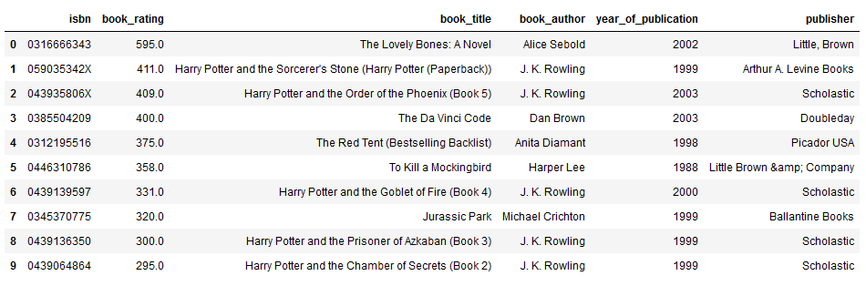
Popularity-Based Recommendation System
Created by count of user ratings across various books. To no one’s surprise, the Harry Potter line of books are very popular!

Slide 11
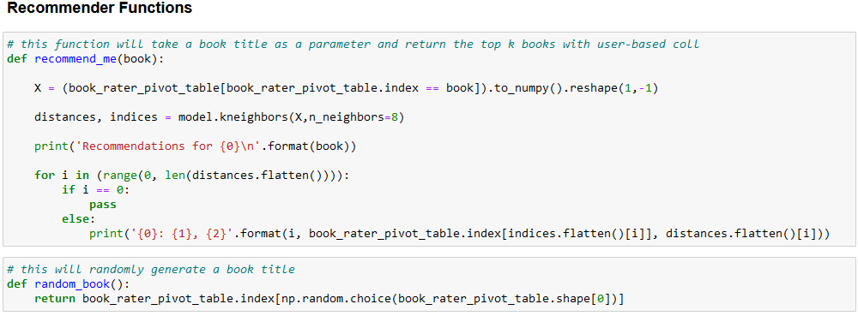
Brief Code Walkthrough - Continued
Make Pivot Table book_rater_pivot_table = pd.pivot_table(df_filtered, values = 'book_rating', index='book_title', columns='user_id')
Fillna’s to Zero book_rater_pivot_table = book_rater_pivot_table.fillna(0)
Create 2D Matrix from scipy.sparse import csr_matrix
book_rater_matrix = csr_matrix(book_rater_pivot_table.values)
Model Training w/ KNN from sklearn.neighbors import NearestNeighbors
knn_model = NearestNeighbors(algorithm ='auto', metric='cosine')
knn_model.fit(book_rater_matrix)

Slide 12
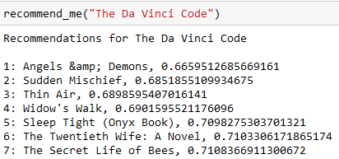
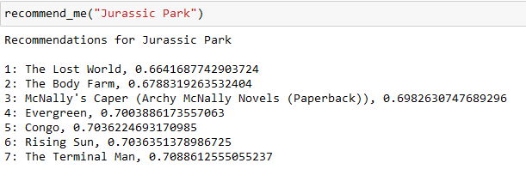
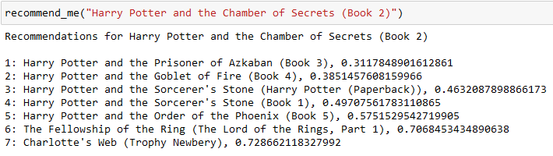
Recommendation Test!!!

Slide 13
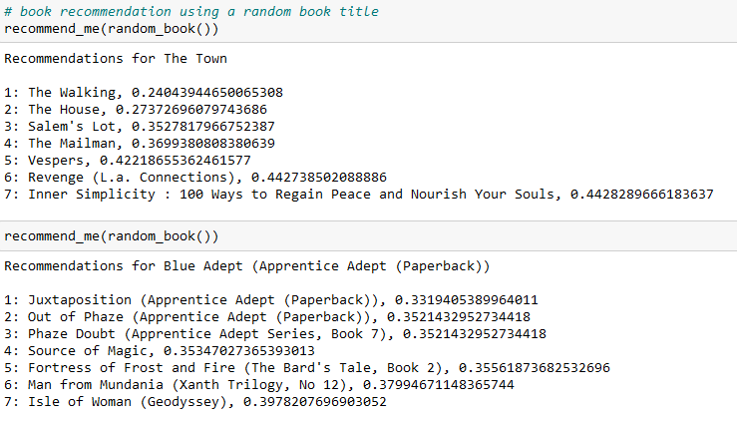
Bonus~ Random Book Generator
Bonus! Random Book Generator

Slide 14
Advantages and Disadvantages of Collaborative Filtering
Not necessary to have domain knowledge
Can help users discover new interest
Good starting point. Only need a feedback matrix
Can’t handle new items: cold-start problem
Data Sparsity: user-item matrix often too large
Synonyms: many similar items have different names. Recommender systems will treat them differently

